Slide 1
CS217
Week 05 Lec 03

Slide 2
Static Members of a C++ Class
We can define class members static using static keyword.
When we declare a member of a class as static it means no matter how many objects of the class are created, there is only one copy of the static member.
A static member is shared by all objects of the class.

Slide 3
Static Members of a C++ Class
It can be initialized outside the class using the scope resolution operator :: to identify which class it belongs to.
All static data is initialized to zero when the first object is created, if no other initialization is present.

Slide 4
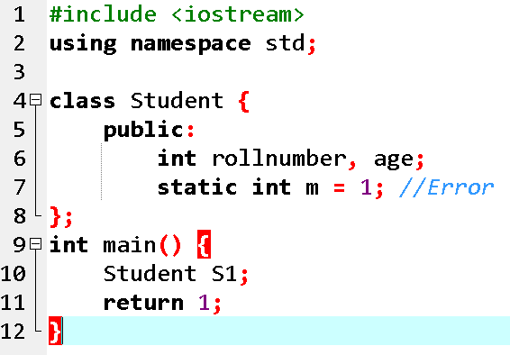
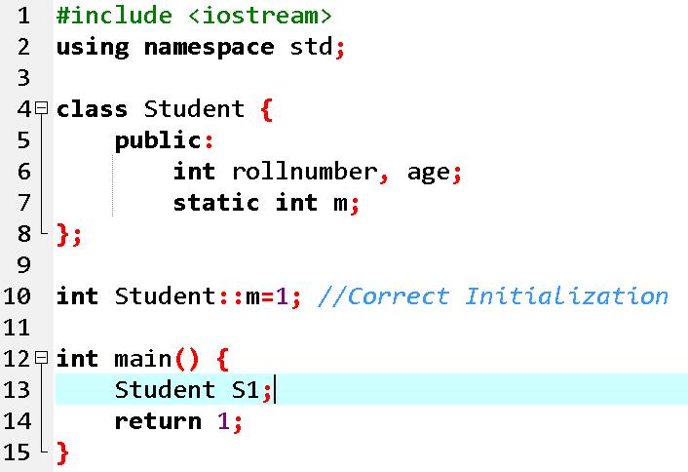
Concept: Static Members can be initialized outside the class

Slide 5
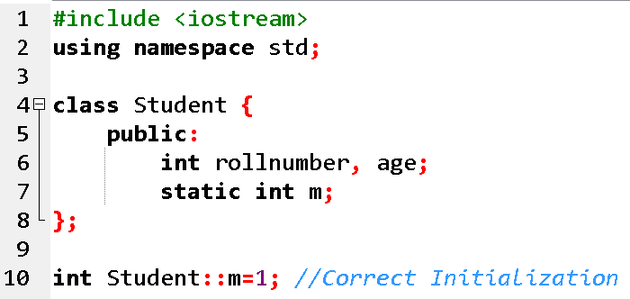
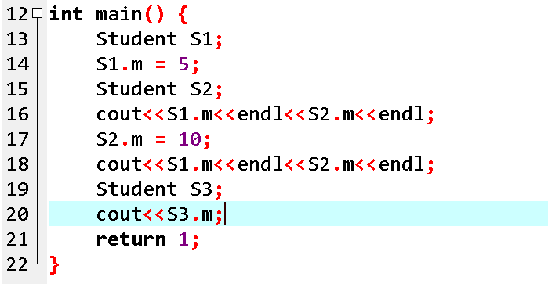
Concept: A static member is shared by all objects of the class

Slide 6
Static Member Functions of a C++ Class
By declaring a function member as static, you make it independent of any particular object of the class
A static member function can be called even if no objects of the class exist and the static functions are accessed using only the class name and the scope resolution operator ::.

Slide 7
Static Member Functions of a C++ Class
A static member function can only access static data member, other static member functions and any other functions from outside the class.

Slide 8
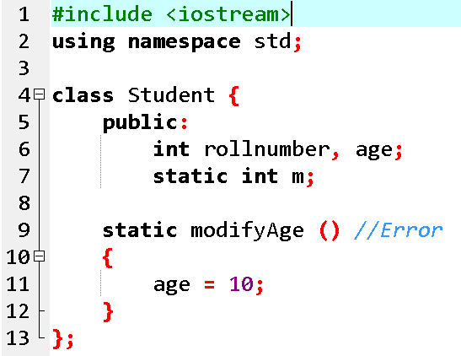
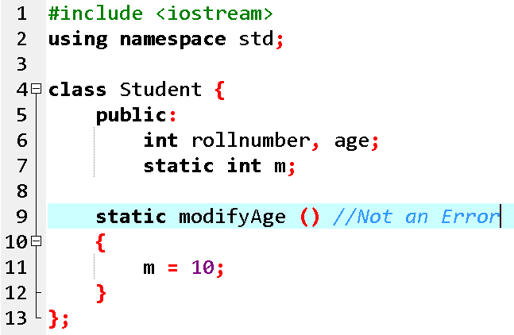
Concept: A static member function can only access static data member

Slide 9
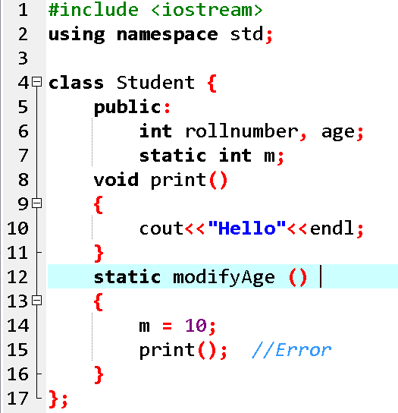
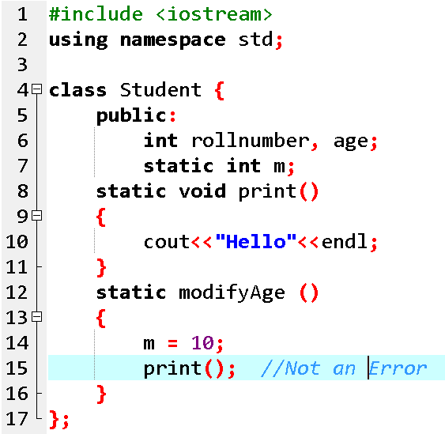
Concept: A static member function can only access other static member functions

Slide 10
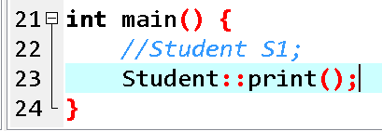
Concept: A static member function can be called even if no objects of the class exist

